Slide 1
Medicare Insurance How Credit Union’s Are Winning By Offering Medicare To Their Members
Presented by Stanton Furness with MedicareCUSO

Slide 2
What is Medicare?

Slide 3
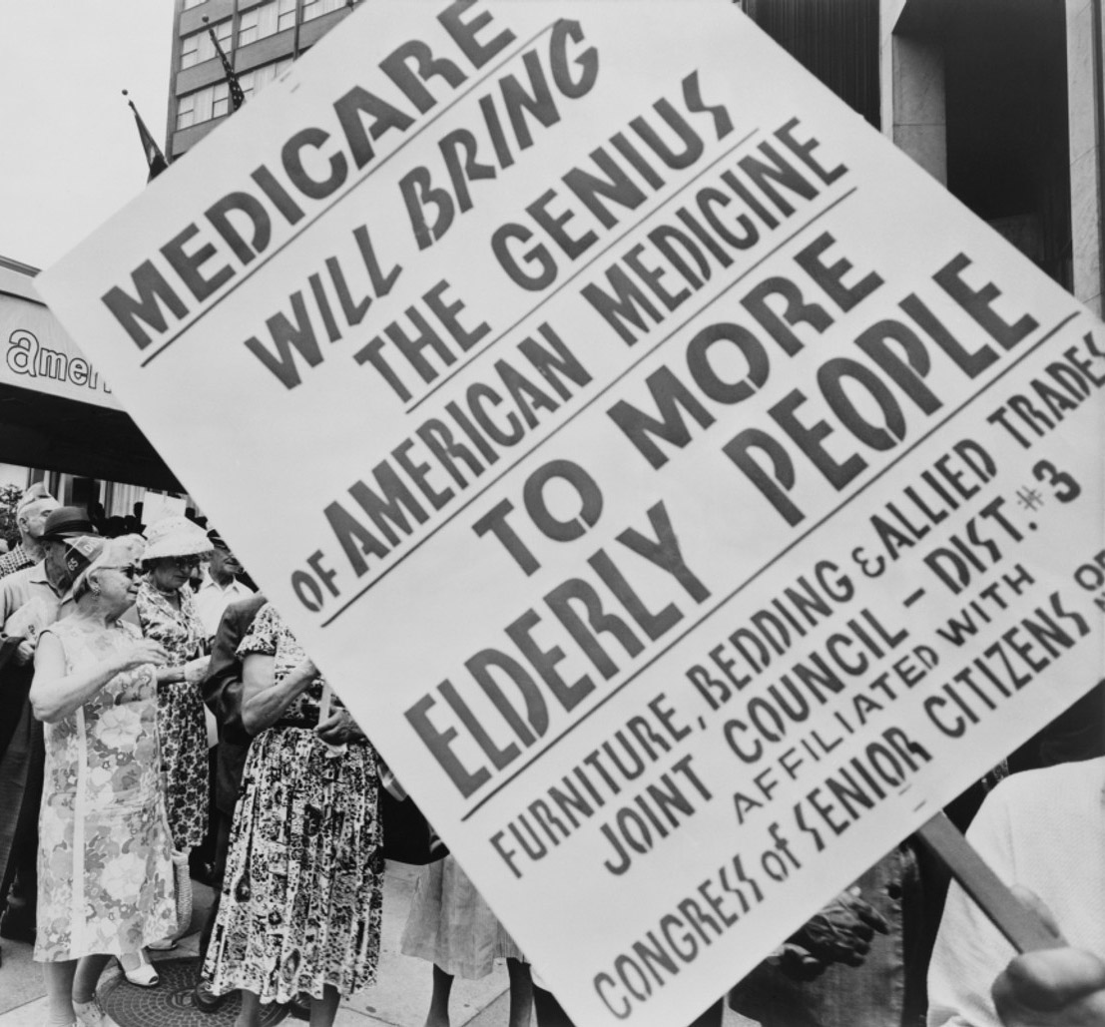
History of Medicare
1965: Medicare (Part A & B)
1980: Medigap Introduced
2003: Medicare Rx improvement and Modernization Act
2005: Medicare Advantage (Part C)
2006: Prescription Drug Program (Part D)
2010: Patient Protection & Affordable Care Act (PPACA)

Slide 4
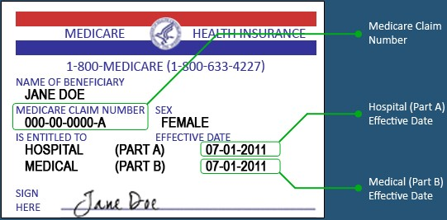
Medicare Beneficiary Identifier
Your Medicare number is a unique combination of numbers and letters.
The numbers are 0-9 and the letters S,L,O,I,B and Z are never used.

Slide 5
Eligibility
People aged 65 and older
Citizens of the USA for 5 consecutive years
People under 65 with a disability receiving 24 months of SSI
People of all ages with End Stage Renal Disease or ALS

Slide 6
The Medicare Opportunity

Slide 7
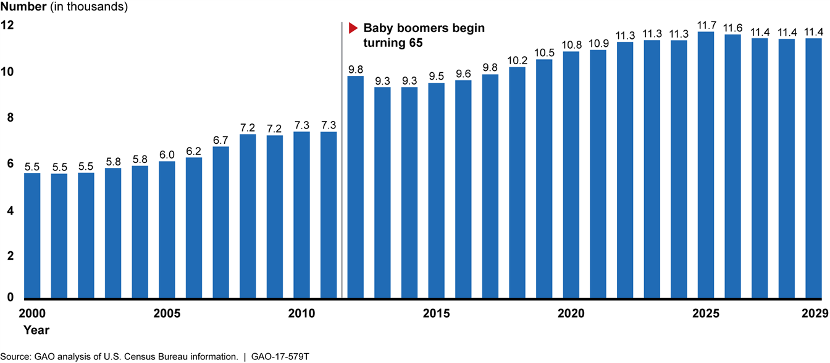
Boomers Turning 65 Each Year

Slide 8
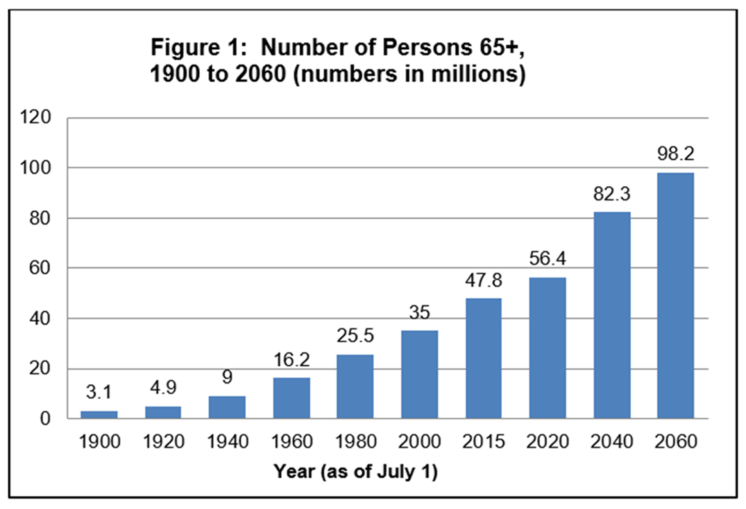
Demographics Matter

Slide 9
How can
Credit Unions Help Member’s with
Medicare?

Slide 10
CU’s Provide Expert Broker Services That:
Help member’s sign up for Original Medicare Parts A & B
Help Member’s delay Part B if they continue to work past age 65 and have qualified coverage elsewhere.
Help members apply for extra help through Social Security or Medicare
Help Member’s choose coverage beyond Original Medicare which include:
Select the best Medicare Supplement and Part D Drug Plan or
Select the best Medicare Advantage Plan for their needs
Making sure the member’s Providers are within the plan network
Making sure the members Prescription drugs are covered at the lowest cost possible.
Help members Shop and find a new plan when needed
Act as an additional resource with plan questions or problems

Slide 11
Flexible Model
Managed Program
Credit Union partners with a vender who offers Medicare services, vendor offers following services to members
Self-Directed Program
Credit Union gets Medicare contract from Medicare FMO (vender), credit union offers following services to members

Slide 12
Coverage beyond
Original
Medicare

Slide 13
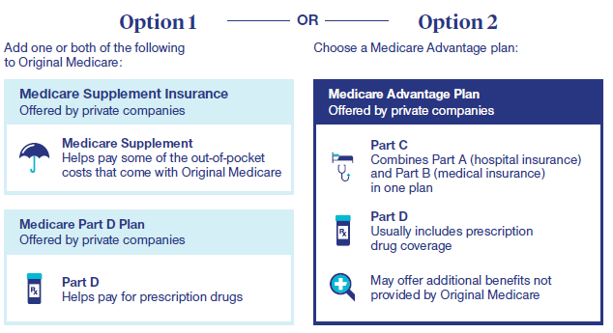
Two ways to get additional coverage

Slide 14
Commission by Product Medicare Advantage Plan + Rx (MAPD)
Turning 65 / Initial Part B Enrollment
$611 - $750 – (Agent Commission) Varies by State & Carrier
Policy Renewal
$305 - $375 – (Agent Commission) Varies by State & Carrier
Note Agency Override Commission of 10% - 30%
Varies based on Carrier, State & Contract Level

Slide 15
Commission by Product Medicare Supplement Plan + Prescription Drug Plan
Turning 65 / Initial Part B Enrollment
Med Supp Plan: 22% or ($22 - $33) Per month – (Agent Commission)
Varies By State & Carrier
Prescription Drug Plan: $6.75 per month – (Agent Commission)
Varies by State & Carrier
Policy Renewal
Med Supp Plan: 22% or ($22 - $33) Per month – (Agent Commission)
Varies By State & Carrier
Prescription Drug Plan: $6.75 per month – (Agent Commission)
Varies by State & Carrier
Note: Agency Override Commission of 10% – 30%
Varies based on Carrier, State & Contract Level

Slide 16
Marketing Strategy?
Turning 65
1. 64 ½ Birthday Card
2. Follow up email
3. Follow up letter (60 days out)
4. In person or phone appointments
are scheduled.

Slide 17
Marketing Strategy?
Medicare 101 Webinars
1. Zoom Meetings held monthly – Education only events
2. Marketing targets wider age range (60 – 80)

Slide 18
Marketing Strategy?
Annual Enrollment Period (AEP)
1. Oct 15th – Dec 7th each year
2. Time of year anyone already on Medicare can make a plan change.
Update the members on what is going to change for next year
Review doctors, medications, and plan benefits
Meetings are held in various branch locations, phone, or Zoom

Slide 19
Medicare Program
Education- for Membership
Seminars- offered during AEP
Referrals- received from Credit Union/Sales Department helps with coaching for qualified referrals
Local Table Events
Partner with Senior Centers
Lunch and Learns with Business Development

Slide 20
Thank you for attending!
MedicareCUSO values your feedback. Please complete a brief survey in the mobile app about this session.

